Slide 1


In-Class Quizzes
ASEN 3728 Aircraft Dynamics
UNIVERSITY OF COLORADO BOULDER

Slide 2
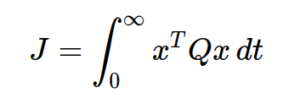
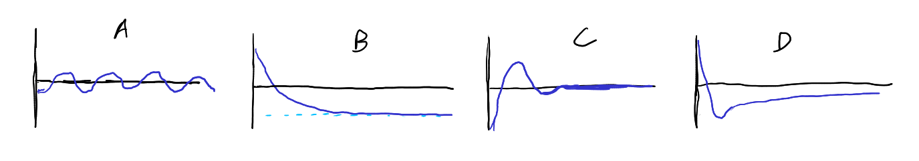
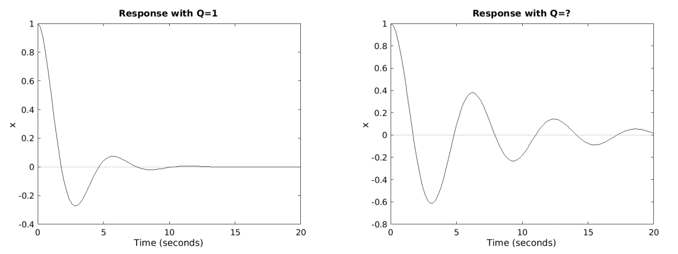
April 25th Quiz
1. According to the cost function at right, which state trajectory has the lowest cost?
2. The two plots below show the response of a single-input system controlled with an LQR controller. The controllers used for both plots use the same values for Q, and the controller on the left uses R = 1. What value of R does the controller on the right use?
Response with R = 1
Response with R = ?

Slide 3

April 18th Quiz
What effect does a washout filter have on an input signal?
What changes to a state space system are required to simulate an integral controller?
A yaw damper is best classified as what type of automatic flight control system?
Integral control tends to add what type of undesirable behavior?

Slide 4

April 9th Quiz
Which of these equations is related to spiral mode approximation?
Which of these equations is related to the roll mode approximation?
Which degree of freedom is modeled in the 2x2 dutch roll approximation?
True or False: If all eigenvalues of the longitudinal dynamics matrix are in the left half plane, we can conclude that the aircraft is statically stable.

Slide 5


Slide 6
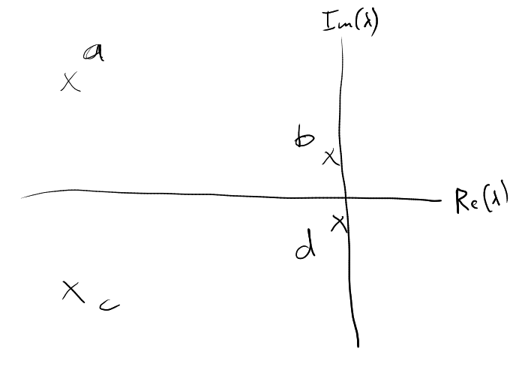

March 5th Quiz
In the image at right, which depicts the longitudinal eigenvalues of a conventional aircraft, which poles correspond to which mode?
A 2x2 matrix has eigenvector [3; 1]. Which of these vectors is also an eigenvector?
The short period mode most prominently involves oscillations in which variable?

Slide 7

Feb 27th Quiz
If the pitch angle is 14 degrees and the angle of attack is 5 degrees, what is the flight path angle?
What is the linearized equation for ?
For an airplane to be statically stable, the center of gravity must be _____ the neutral point.
$Δ\overset{˙}{q}$

